Slide 1
Appendix D
Profile Boundary
Conditions
Introduction to CFX

Slide 2
Profile Boundary Conditions
Rather than using constant values of variables (velocity, pressure, temperature, etc), it is more accurate to use experimental results and create profile boundary conditions based on interpolation of values from data files
Another option is to create a profile boundary from results at some location in a previous simulation
Results File from First Simulation
CFD-Post
CFX-Pre
Definition File for Second Simulation
Profile Data File

Slide 3
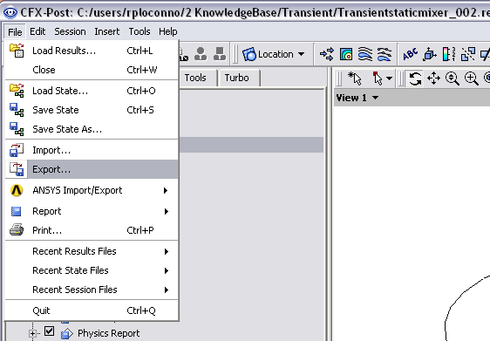
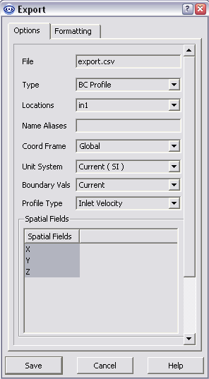
How to Use
Results File from First Simulation
CFD-Post
CFX-Pre
Definition File for Second Simulation
Profile Data File
Inlet Velocity
Outside Temperature
Pressure Profile
Relative Pressure
Relative Static Pressure
Static Temperature
Stationary Frame Total Temperature
Total Temperature
User Defined Variables

Slide 4
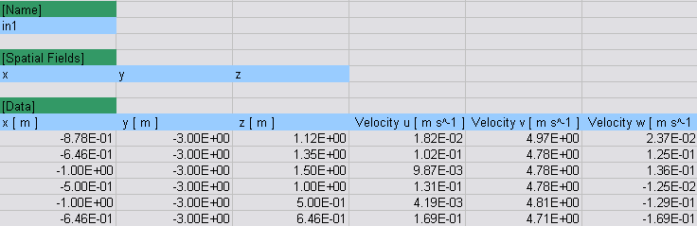
How to Use
Results File from First Simulation
CFD-Post
CFX-Pre
Definition File for Second Simulation
Profile Data File
Example of the BC file from CFD-Post. The information in the colour boxes is needed and will be read automatically by CFX-Pre

Slide 5
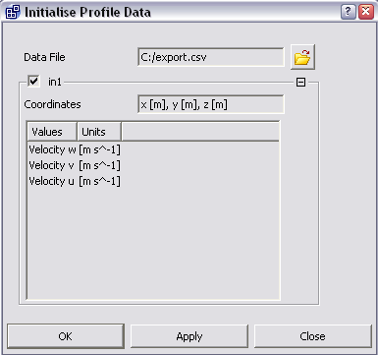
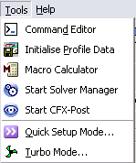
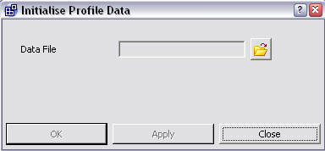
How to Use
Results File from First Simulation
CFD-Post
CFX-Pre
Definition File for Second Simulation
Profile Data File
Initialize (read in) the profile in CFX-Pre. Do this by selecting Tools>Initialize Profile Data and selecting the profile file. You can load multiple profile files and each file can be applied in more than one location

Slide 6
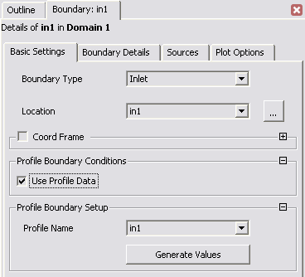
How to Use
Results File from First Simulation
CFD-Post
CFX-Pre
Definition File for Second Simulation
Profile Data File
Assign the profile data to a boundary condition
Select the appropriate profile from the drop-down list, then click Generate Values

Slide 7
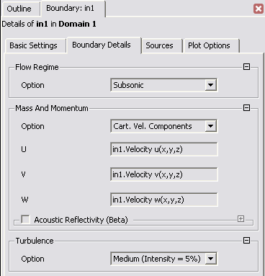
How to Use
Results File from First Simulation
CFD-Post
CFX-Pre
Definition File for Second Simulation
Profile Data File
The Boundary Details panel will be modified to use the profile data
These changes will not be applied unless you click Apply
Tip: you can shift a profile by modifying the x, y, z values passed into the function, e.g.
  in1.Velocity u(x+10[m],y,z)

Slide 8
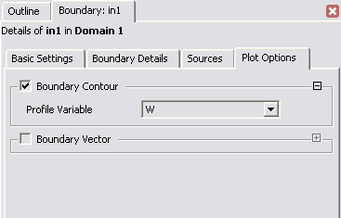
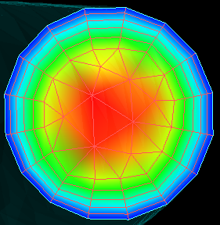
How to Use
Results File from First Simulation
CFD-Post
CFX-Pre
Definition File for Second Simulation
Profile Data File
Boundary conditions can be visualized in CFX-Pre
You can create a Boundary Contour or a Boundary Vector plot of the profile data

Slide 9
How to Use
Results File from First Simulation
CFD-Post
CFX-Pre
Definition File for Second Simulation
Profile Data File
The profile data is read into the CFX-Solver each time the solver is started / restarted (i.e. the profile file can be edited between solver runs without returning to CFX-Pre
CFX-Pre
.def & .csv
CFX-Solver
.res
CFD-Post

Slide 10
How to Use
Results File from First Simulation
CFD-Post
CFX-Pre
Definition File for Second Simulation
Profile Data File
CFX-Pre
.def & .csv
.out (includes .csv data if profile data is less than 16 kB)
CFX-Solver
.res (including .csv data)
All profile data is written to the results file and can be extracted using the command line utility cfx5dfile, described in the Help Files
CFD-Post

